Slide 1
Intro to Autodesk Maya
Companion Document for:
LMC Class - Intro to Animation
LMC Class - 3D Modeling and Animation
Teacher: Ty Carriere Email: TyTaughtMe@gmail.com
Ver. 2 / 8-23-16

Slide 2
What is Maya
Professional 3D software used in major feature films, video games, motion graphics, FX houses, commercial, television, etc.
Used for 3D modeling, Animation, Visual Effects (FX),
Used by Pixar, EA, Industrial Light and Magic, Marvel Studios, Disney, Etc.

Slide 3
Maya Setting a project
First create a folder on your partition that the file will be using.
Next goto File/ Project Window/ New and a menu will come up.
Type in the name of your project, then under location chose the folder that you created.
Next VERY IMPORTANT, click use defaults at the bottom of the menu, then Accept.
Next time you want to work on your project just select it by going to recent projects.
Otherwise (since the project is already created now). Just go to File/ Set Projects and point to the folder that was created for you project.

Slide 4
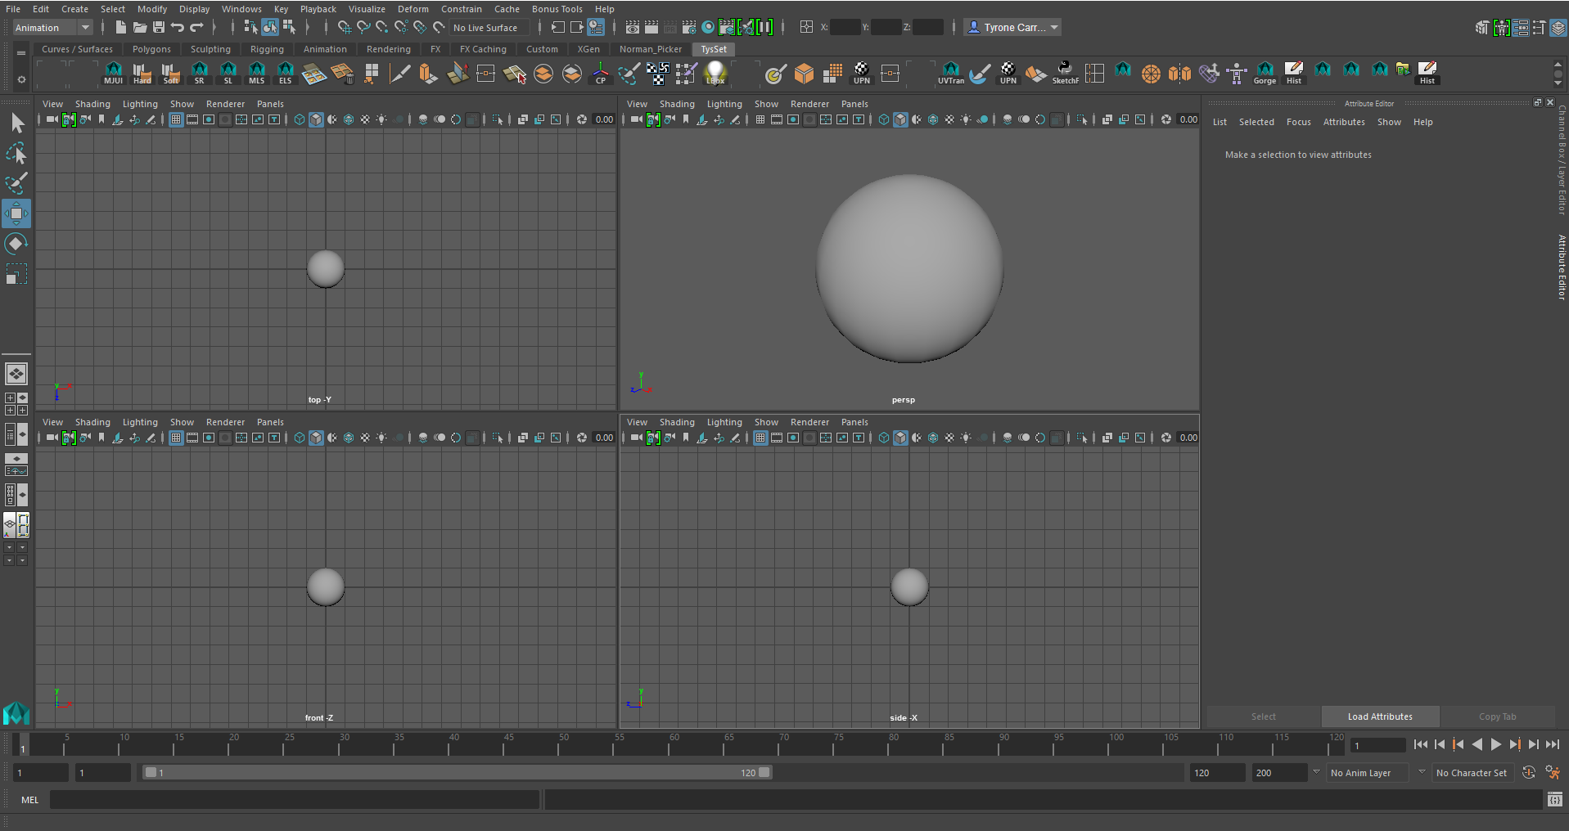
Maya Interface
When you open Maya, you might see a interface like this. Maya has dozens of menus and dozens of buttons. Don‘t feel intimidated. You won’t have to remember most of them. Just the ones that you use regularly so don’t worry.
Lets go over the interface that you’ll be using the most:

Slide 5
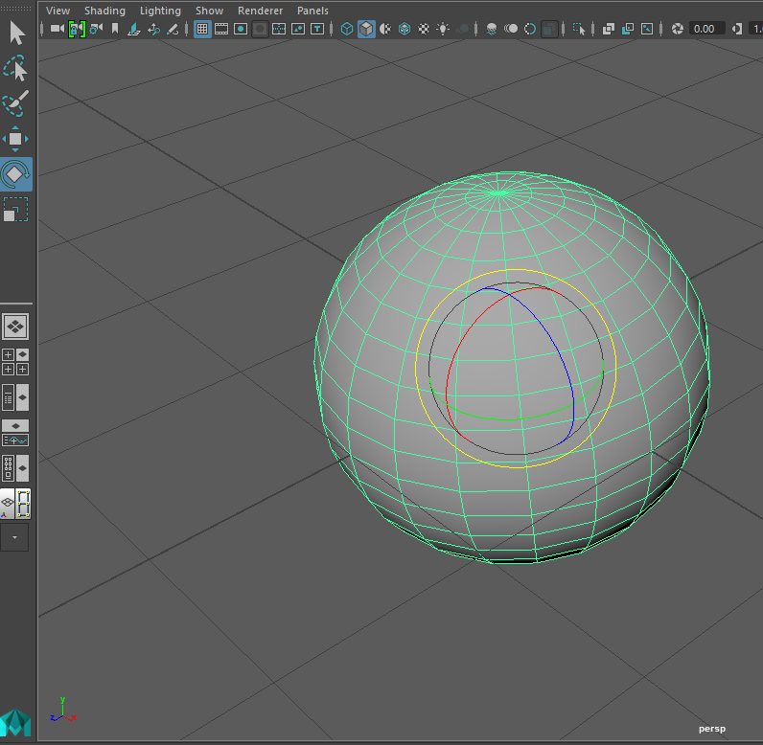
Maya Interface
To the left of the Maya interface is your main tools. Maya uses a QWERTY key interface. What that means is that the main shortcut keys in Maya are assigned to the QWERTY keys. They can also be accessed through the buttons to the left. Here is a list of them
Selection Tool “Q”
Lasso Tool
Paint Selection Tool
Move/Translate Tool “W”
Rotate Tool “E”
Scale Tool “R” Manipulator School “T”

Slide 6
Maya Interface
These tools allow you to manipulate objects that you will model and animate. They allow you to select them, move them, rotate them and scale them.
Selection Tool “Q”
Lasso Tool
Paint Selection Tool
Move/Translate Tool “W”
Rotate Tool “E”
Scale Tool “R” Manipulator School “T”

Slide 7
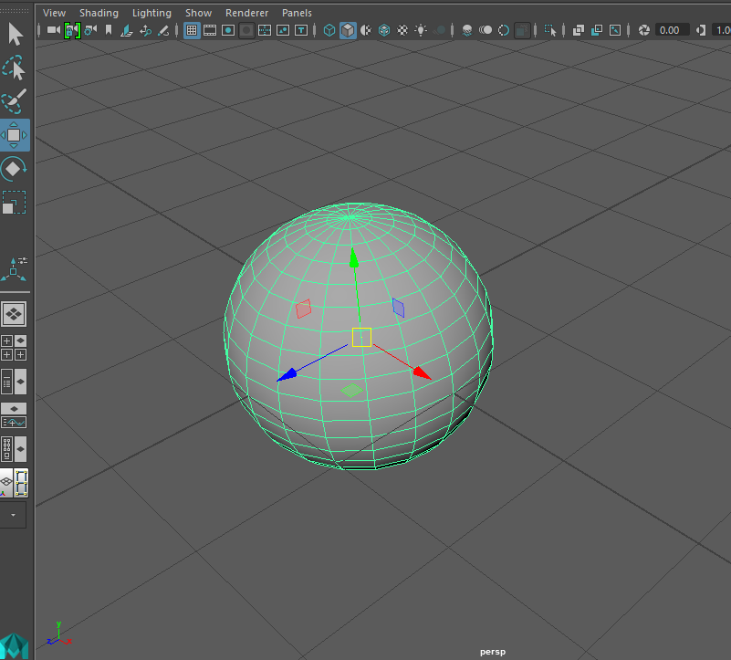
Maya Interface
Move/Translate Tool “W”
When you chose a manipulator like the move tool and have a object selected, the manipulator will change to reflect which tool you’ve chosen. Arrows for the Move/Translate tool, Circles for the rotate, Boxes for the scale.

Slide 8
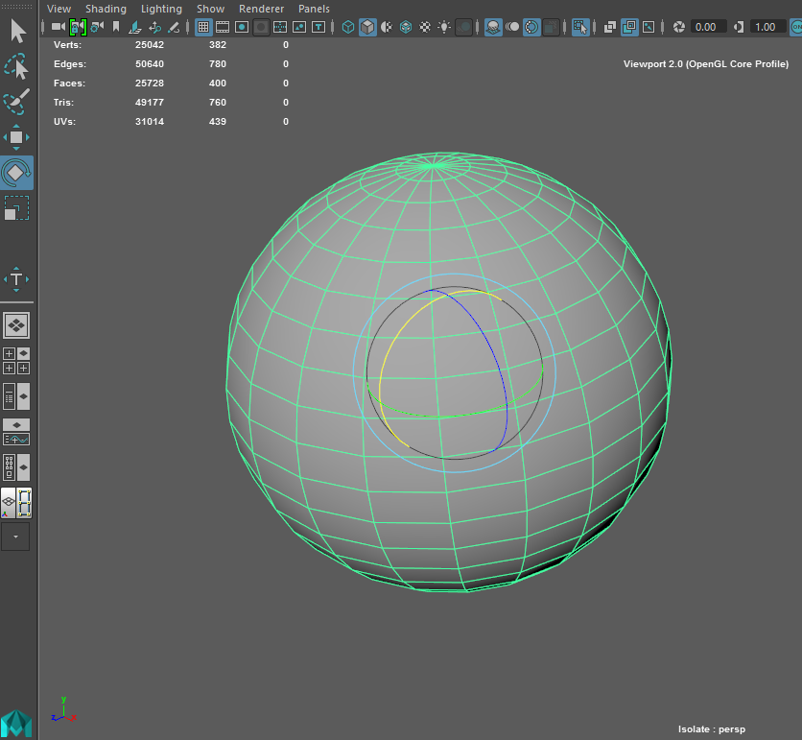
Maya Interface
Rotate Tool “E”
When you chose a manipulator like the move tool and have a object selected, the manipulator will change to reflect which tool you’ve chosen. Arrows for the Move/Translate tool, Circles for the rotate, Boxes for the scale.

Slide 9
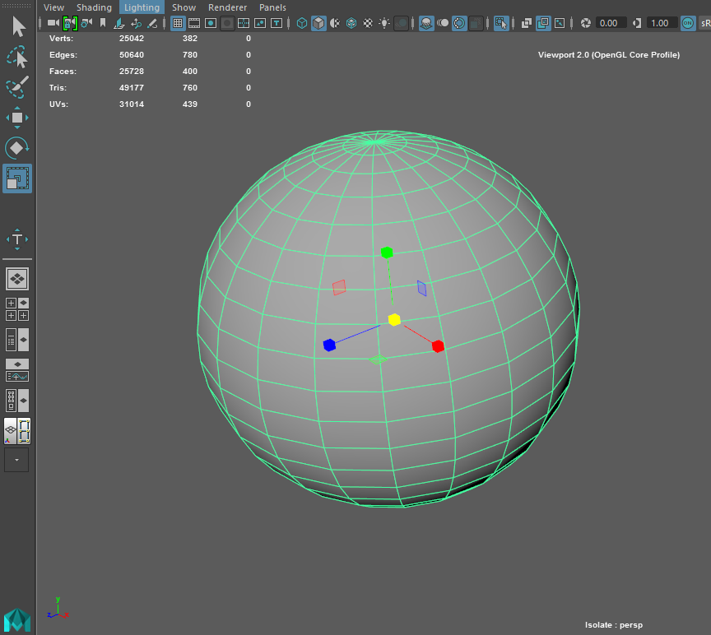
Maya Interface
Rotate Tool “R”
When you chose a manipulator like the move tool and have a object selected, the manipulator will change to reflect which tool you’ve chosen. Arrows for the Move/Translate tool, Circles for the rotate, Boxes for the scale.

Slide 10
Maya Interface
Rotate Tool “R”
When you chose a manipulator like the move tool and have a object selected, the manipulator will change to reflect which tool you’ve chosen. Arrows for the Move/Translate tool, Circles for the rotate, Boxes for the scale.

Slide 11
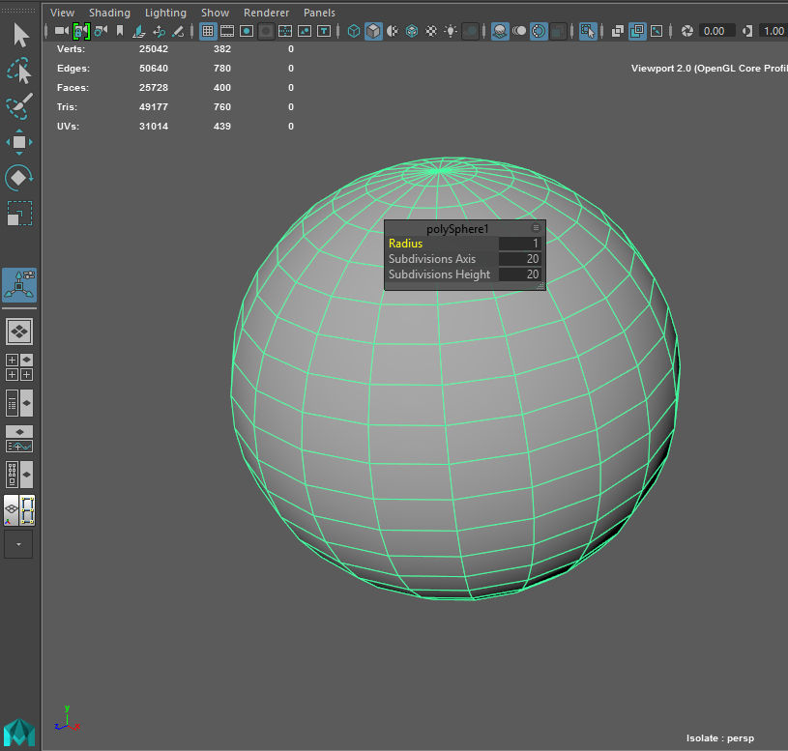
Maya Interface
Manipulator Tool “T”
The manipulator tool allows you to do multiple things including adjust the properties of a recently created primitive such as how many divisions it has.

Slide 12
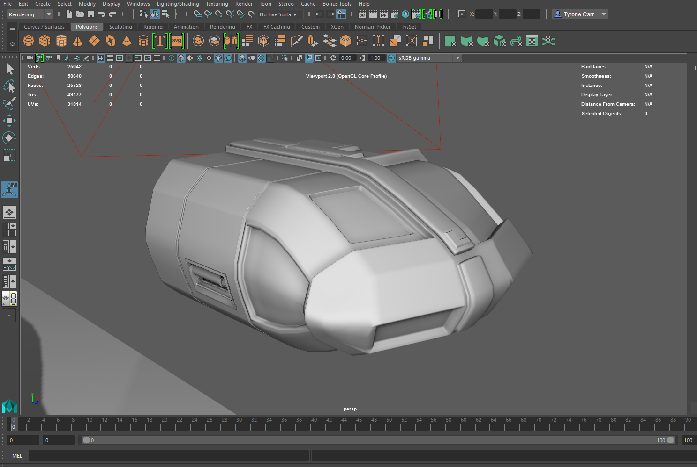
Maya Interface
Create Primitives
The Poly tools to the Right are the ones we’ll be using the most.
They only work on polygon objects and help to shape simple primitives into whatever object you like.
The best primitive to start with is a cube. Then by extruding and splitting faces you can obtain the level of detail needed with out making a overly dense model.
Use your right mouse button (RMB) with the cursor over a object to go into different modes.
Vertex, Edge, Object mode and Face are the modes you will me toggling through.
Vertex: allows you to move the individual points that make up the object.
Edge: are the lines and dividers between the Vertices.
Object: is the regular mode of either moving or scaling the entire object and not just a piece of it.
Face: is referring to the poly face that fill geometry between the edges. It’s literally the surface that is being created.

Slide 13
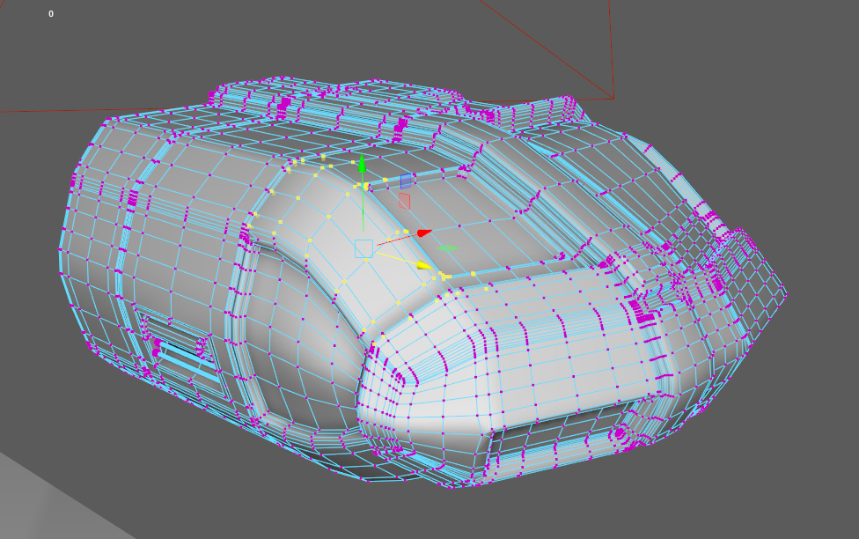
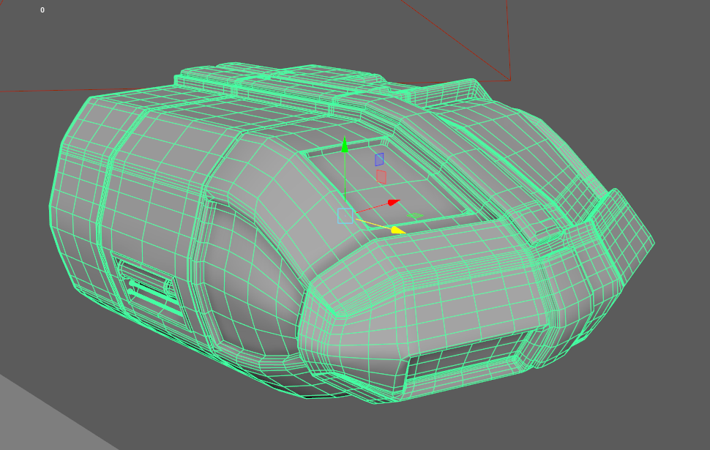
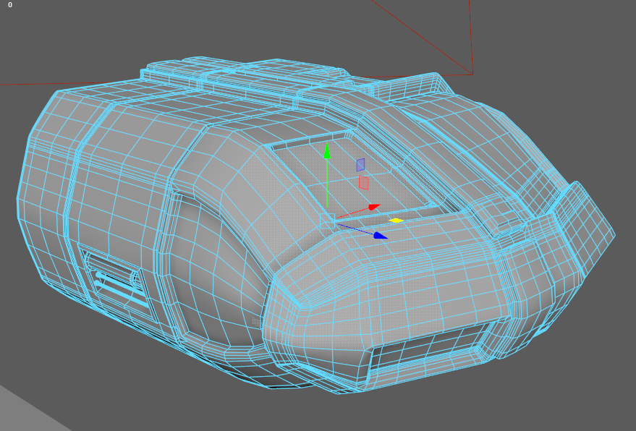
Poly Tools
Selected Verticies
The Poly tools to the Right are the ones we’ll be using the most.
They only work on polygon objects and help to shape simple primitives into whatever object you like.
The best primitive to start with is a cube. Then by extruding and splitting faces you can obtain the level of detail needed with out making a overly dense model.
Use your right mouse button (RMB) with the cursor over a object to go into different modes.
Vertex, Edge, Object mode and Face are the modes you will me toggling through.
Vertex: allows you to move the individual points that make up the object.
Edge: are the lines and dividers between the Vertices.
Object: is the regular mode of either moving or scaling the entire object and not just a piece of it.
Face: is referring to the poly face that fill geometry between the edges. It’s literally the surface that is being created.
Selected Object
Vertex Mode
Selected Faces
Object Mode
Face Mode

Slide 14
Poly Tools pt.2
Extrude
This is the manipulation tool that appears after you extrude a face. This allows you to move, scale and rotate an extruded face. You can also change to a normal QWERTY tool to manipulate the face once it’s extruded.
Remember that when you’re Extruding faces you have the option of keeping them together or not. This becomes important because you don’t want to have extra faces where you don’t need them or where you can’t see them. This makes the model more dense then it needs to be and also can screw up renders.
Face Mode

Slide 15
Render Globals
Rendering Menu
Render Settings
Remember that your rendered images go into the images folder of your project.
File Name for Render
File format
Rendering Menu
Naming convention
Frame Padding (4)
Render
Snapshot
Render Region
IPR refresh
Render Settings
IPR (Interactive Photorealistic Renderer
Render Camera (Very important)
Resolution (use HD720)
Pixel Resolution (72 ppi)

