Slide 1
Intro to Animation 3D Modeling and Animation
Ty Carriere TyTaughtMe@gmail.com

Slide 2
Intro to the class
Who am I
What we will learn
Animation Basics
Modeling
Lighting
Digital Sculpting
Making a Reel

Slide 3
Software
What we will learn
Maya (free for students) A Program used for games and movies for modeling, animation, VFX, Rendering, UV Mapping, Low Poly modeling on high res,
Mudbox (free for students) A program used for Digital Sculpting characters and detailed objects in high res for the bases of low res objects used in games and movies. Also used for texturing and hand painting on 3D Models.
Audacity Sound editing software
Making a Reel Quicktime – playing and editing movies Imovie - Creates movies with titling and effects that can be posted on the web or burned to dvd Fcheck – Conversion of image sequences to movies (comes with Maya)
Most of the software we’re using is actually free for students!!!! They are also available for both PC and MAC Maya and Mudbox are available on the Autodesk site. Audacity is also a free download.

Slide 4
Suggested Accouterments
USB Flash drive 8Gb or larger This will be used by you to back up your files (Don’t put all your eggs in one basket)
Notepads, Recording devices or some other mechanism for taking notes Taking notes is an important part of any class. Some students will use their phones to record lectures. Some students keep their email or Word open and type notes then email them to themselves.
Youtube/Google Youtube is an awesome resource when you’re not just looking up embarrassing videos. If you have a question and the teacher isn’t available at the moment. Try looking it up. There are countless videos and resources online.
Camera A lot of what we do will require references like pictures of objects, videos of people, etc. If you have a phone or device that can record, this will come in useful. If you don’t, don’t stress. When the time comes, the teacher has resources you can use.

Slide 5
Modeling
What we will learn
Maya Basic Navigation Cameras poly-modeling Image Planes Modeling Tools
Audacity Sound Editing
Mudbox Digital Sculpting Brushes Texturing
Making a Reel Quicktime Imovie FCheck

Slide 6
Animation
The 12 Principles of Animation
1.1 Squash and stretch
1.2 Anticipation
1.3 Staging
1.4 Straight Ahead Action and Pose to Pose
1.5 Follow Through and Overlapping Action
1.6 Slow In and Slow Out
1.7 Arc
1.8 Secondary Action
1.9 Timing
1.10 Exaggeration
1.11 Solid drawing
1.12 Appeal

Slide 7
Modeling Considerations
1.1 Silhouette
1.2 Spatial Reference / Scale
1.3 Accuracy
1.4 How many pieces to use to build it
1.5 What primitive shapes make it?
1.6 How close is it to the camera (what level of detail do I need to make it?)
1.7 Where are the edges
Reference, Reference, Reference!

Slide 8
Sculpt Considerations
Silhouette
Low to High Detail
Anatomy
Character History
Apparrel
Hair
Accessories
What’s made in Mudbox? What’s made in Maya?
Reference, Reference, Reference!

Slide 9
Lighting Considerations
Mood
Color
Temperature
Primary Source of light ( outdoor lighting, indoor, sun, moon, window, lamp, etc.)
3 point lighting setup
Style
Where are the edges
Reference, Reference, Reference!

Slide 10
Grading
1 Projects
Turned in on time
Be Creative and have fun!
Follow criteria of the assignment
Doing extra scores points
Work hard.
2 Participation (yes you are graded on this)
Critiques (give constructive feedback to other students and accept constructive feedback)
Pay attention during lecture (youtube, constant texting or having unrelated conversations during lecture is not paying attention)
Helping other students - extra credit
Not being disruptive (Talking loud enough to distract other students, over usage of colorful metaphors – yes, I mean cursing)
ASKING QUESTIONS!!!! You can learn on youtube, you’re in school so you can ask questions. Not asking your teacher questions is like having a paid chef that you never ask to cook for you.

Slide 11
Class Conduct
Students are expected to:
Conduct themselves in a fun but professional manner
Be respectful to your classmates and the teacher (learn when to whisper, say excuse me, etc.) Common courtesy and etiquette.
Communicate with your teacher and email if you’re going to miss class or are having any issues.
If you have a hard time paying attention or have any hearing problems, try to sit in the front of the class or notify the teacher
If you have any disabilities where you need accommodations for the class, turn the form in to the teacher by the second week of class and let the teacher know ASAP.

Slide 12
Assignments
Modeling/Lighting
Lighting a scene Room Prop/Furniture Modeling Lamp
Character Sculpture*
Advanced Projects Environment Vehicles
Animation
Bouncing Ball
Logo Animation
Poses
Walking
Ball Toss
Narrative/Lipsync
Blockout
Pose to pose
Lipsync

Slide 13
Final
Demo Reel:
Create a demo Reel of all your work including titling and credits
Final Critique

Slide 14
SECRETS TO SUCCESS:

Slide 15
SECRETS TO SUCCESS:
ATTENDANCE

Slide 16
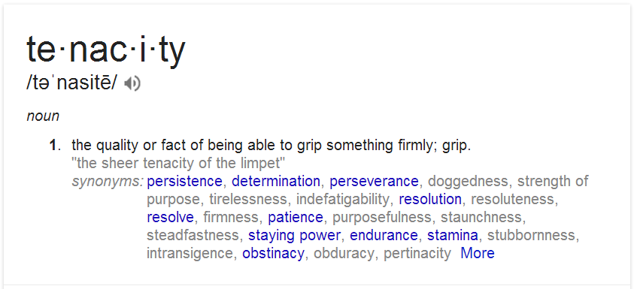
SECRETS TO SUCCESS:
ATTENDANCE
TENACITY

Slide 17
SECRETS TO SUCCESS:
ATTENDANCE
TENACITY
ASK QUESTIONS

Slide 18
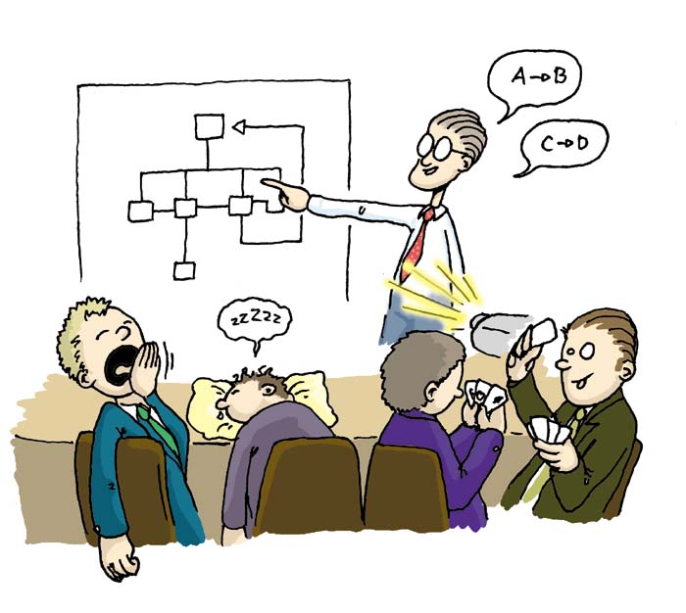
SECRETS TO SUCCESS:
ATTENDANCE
TENACITY
ASK QUESTIONS
PRESENTATION

Slide 19
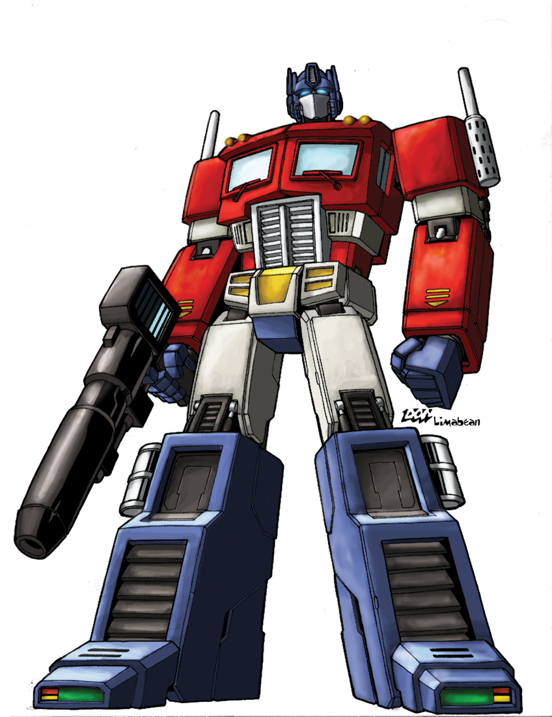
SECRETS TO SUCCESS:
ATTENDANCE
TENACITY
ASK QUESTIONS
PRESENTATION
ATTITUDE

Slide 20
SECRETS TO SUCCESS:
ATTENDANCE
TENACITY
ASK QUESTIONS
PRESENTATION
ATTITUDE
HAVE FUN!!!

Slide 21
SECRETS TO SUCCESS:
Conclusion

